Slide 1
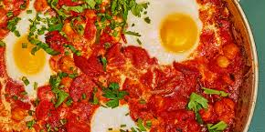
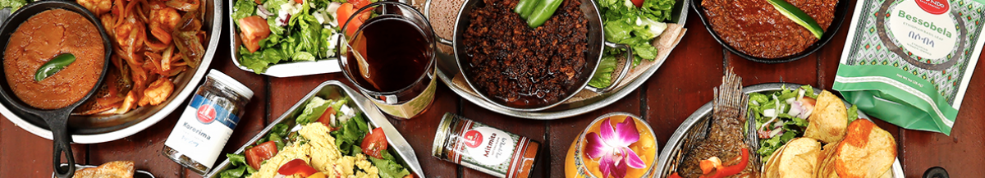

Recipes @ Sakivi:
Cook. Share. Discuss. Repeat.

